Slide 1

OPHES Expansion &
CHIO Certification Update
Connecting You to Health Improvement Opportunities
Public Health Institute of Oklahoma
Jill Hazeldine, Executive Director
Laura Ross, Director of Programs
Adrienne Elder, Director of Early Intervention
publichealthok.org @publichealthok @oklahomachio
Notes:
Opening slide deck, title and imagery will depend on what type of presentation: launch, general, educational

Slide 2

About PHIO
Engaging diverse change agents in
community-designed health care improvement
Established in 2004
501(c)3 nonprofit organization
Neutral convener to bridge academia, communities, nonprofits, and individuals to collaboration health improvement opportunities
Work across diverse sectors to ensure community-voice in local health related activities through it’s portfolio of work
Foster innovation, leverage resources, and support nonpartisan health advocacy
Coordination & Collaboration
Education & Research
Engagement & Innovation
CHIO Certification and OPHES Network connections
Click here to access PHIOs Stakeholder Survey, we want to hear from you!
publichealthok.org @publichealthok

Slide 3
PHIOs Community Reach
PHIO PROGRAMS AND PROJECTS HIGHLIGHT
Communities in Action
  Annual virtual learning series designed in collaboration with PHIO stakeholders. Expert leaders address Oklahoma's most pressing health challenges, opportunities and provide up-to-date resources, data- tools, and research collaborations.
  Learning includes those with lived experience & community members
  CATCH-UP Oklahoma
  Providing COVID-19 response and relief CATCH-UP Oklahoma supports community-designed testing, vaccines, and relief support to marginalized, minority populations and geographies. To date the effort has produced over 400 community events to better address COVID-19 needs locally
Early Intervention
Supporting Oklahoma's vulnerable through promoting and implementing Peer Support Groups, Parent Advisory Councils, Family Resource/HOPE Centers, and the Oklahoma Parent Partnership Learning Community PHIO seeks to enhance pathways of support for those most in need
publichealthok.org @publichealthok

Slide 4
Community Partnership Program
Supporting the delivery of focused health and social care
funding to communities
Funding health and social care projects across Oklahoma
In 2012 the Public Health Institute created the Community
Partnership Program as an innovative pathway to support the delivery of funding to entities
PHIO and its stakeholders to design opportunities for communities to participate in health improvement activities while receiving Incentive Funds.
Incentive Funds are in turn re-invested into the
community to address health disparities and inequities and
remove barriers for local participation.
PHIO has distributed over $1.3 Million in funds since 2012
publichealthok.org @publichealthok

Slide 5
Oklahoma Primary Health Care Extension System
and
community/County Health Improvement Organizations
Notes:
Agenda slide

Slide 6
What is an extension system? How does it work?
What is an extension system?
Cooperative Extension System (CES) empowers farmers, ranchers, and communities of all sizes to meet the challenges they face, adapt to changing technology, improve nutrition and food safety, prepare for and respond to emergencies, and protect our environment. (USDA)
https://nifa.usda.gov/cooperative-extension-system
Notes:
Agenda slide

Slide 7
What is an extension system? How does it work?
How does the extension system work?
University faculty members, who are disciplinary experts, translate science-based research results into language — written, verbal, and electronic — appropriate for targeted audiences. County-based educators work with local citizens and interest groups to solve problems, evaluate the effectiveness of learning tools, and collect grassroots input to prioritize future research. By living and working in communities, county educators are able to rely on existing relationships to respond to local needs, build trust, and engage effectively with citizens. (USDA)
https://nifa.usda.gov/cooperative-extension-system
Notes:
Agenda slide

Slide 8
What is OPHES?
What is the Oklahoma Primary Health Care Extension System (OPHES)?
Established in 2008, OPHES aims to improve available health care for Oklahomans through the coordination of services and the alignment of resources. This includes the provision of emergent community-designed social and medical interventions. OPHES partners include: state agencies, foundations, health care payers, academia, social care organizations, health care providers, coalitions, stakeholder groups, and community members. These partners have aligned their efforts to improve the health outcomes of Oklahomans, independently and collectively.
Notes:
Agenda slide

Slide 9
Why OPHES? Who runs OPHES?
Why OPHES?
Ensure the alignment and maximization of health and social service focused population health projects and programs across diverse stakeholders impacting health and human service outcomes in Oklahoma. Creation of innovative inter-agency approaches to health care delivery.
Who runs the Oklahoma Primary Health Care Extension System?
The Public Health Institute of Oklahoma acts as the managing partner of OPHES. PHIO coordinates with CHIOs and other stakeholders to connect communities to population health focused opportunities aligned with localized need. Through deeply cultivated partnerships PHIO is able to rapidly engage traditional and non-traditional partners in designing, piloting, deploying, evaluating, and sustaining community-designed interventions
Notes:
Agenda slide

Slide 10
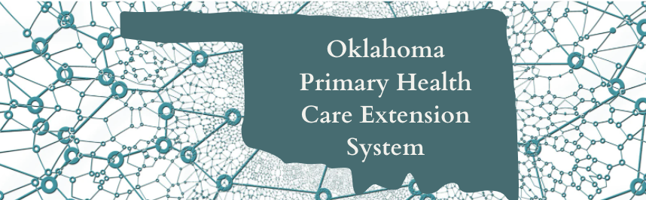
Oklahoma Primary Health Care Extension System
Notes:
Agenda slide

Slide 11
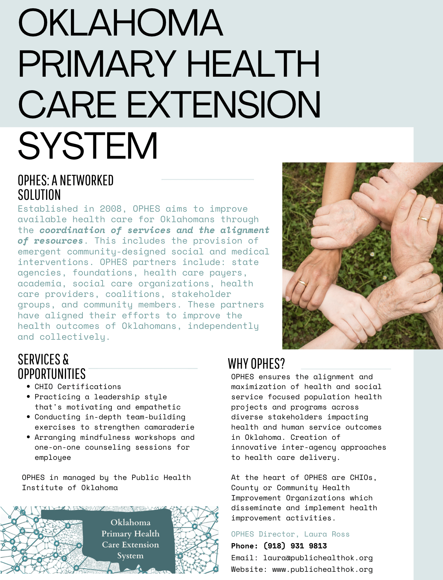
Oklahoma Primary Health Care Extension System
Notes:
Agenda slide

Slide 12
Who is PHIO? Who Supports OPHES?
Who is PHIO?
Established in 2004, the Public Health Institute of Oklahoma (PHIO) is a nonprofit organization committed to acting as a neutral convener to bridge government, academia, and communities for collaborative health improvement. PHIO fosters innovation, leverages resources, and supports nonpartisan health advocacy through its work across the state. PHIO works across diverse sectors to ensure a community-voice in local health related activities through it’s portfolio of work.
Who supports OPHES activities?
OPHES activities are financially supported by the Oklahoma Clinical and Translational Science Institute at the University of Oklahoma. Additional OPHES activities are supported by the Oklahoma Primary Health Care Improvement Cooperative, United Health Care, Center for Health Systems Innovation at Oklahoma State University, Robert Wood Johnson County Health Rankings and Road Maps, Oklahoma State Department of Health, Rural Health Association of Oklahoma, Rural Health Network of Oklahoma, Legal Aid Services of Oklahoma, The Lynn Foundation, Handle with Care, and the Oklahoma Turning Point Council.
Notes:
Agenda slide

Slide 13
How OPHES Works
How does OPHES work?
Interested entities are encouraged to apply for membership to OPHES. Initial OPHES membership is offered to all qualified entities at no-charge. Additional membership add-ons are offered at cost. Add-ons support the expansion of OPHES efforts and overall sustainability of the network. At the heart of OPHES are Community & County Health Improvement Organizations (CHIOs) organized to support localized health improvement activities.
What is a CHIO? Why CHIOs?
And why do you want to be one?
Connecting you to Health Improvement Opportunities
Notes:
Agenda slide

Slide 14
CHIO
A CHIO is a noun and a verb.
A CHIO is what you do. A CHIO is who you are.
The CHIOs are a network of like-minded health care improvement agents supported by the Oklahoma Primary Health Care Extension System (OPHES). CHIOs are the heart of OPHES.
Being Certified as a CHIO signifies your community’s desire to collectively improve the health of those you serve, while acknowledging your entity’s ability to operate a high standard of practice while serving. Being a CHIO signals to those around you your willingness and readiness, your capacity and capabilities all while highlighting your community’s uniqueness and expertise. And it’s more… It’s about being a part of something bigger. It’s about the connections, the relationships which make the landscape of Oklahoma health care different. We want you to be a part of making a difference!
Notes:
Agenda slide

Slide 15
CHIO
What is a Community or County Health Improvement Organization (CHIO)?
The concept of a CHIO was introduced by The University of Oklahoma, Dept. of Family Medicine (OU-Dept. of FM) in 2008 in an effort to bring community-driven health focused dissemination and implementation projects to rural Oklahoma. A CHIO Certified entity is an organized group of stakeholders supporting health care improvement activities within a community, communities, a county, or multiple counties. Each CHIO is Certified by PHIO through a review process designed to ensure a multi-sectorial approach to improving health within an identified community.
Each CHIO represents an entity operating at a high level of practice. Certification are offered at 3 levels: cHIO, CHIO, and CHIO+.
Notes:
Agenda slide

Slide 16
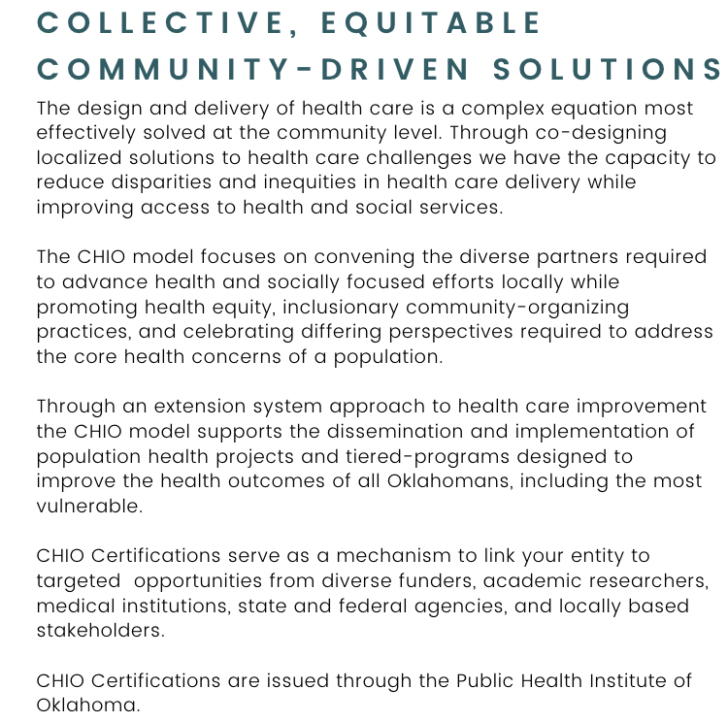
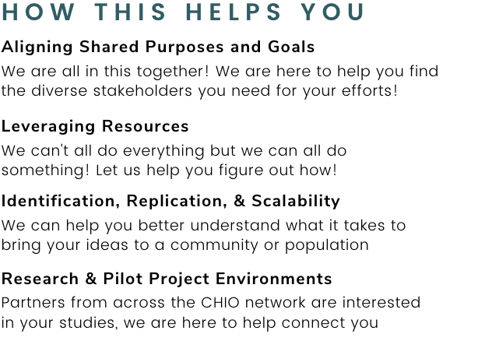
Re-Introducing the CHIO Model
A network of networks approach to health care improvement
Notes:
Agenda slide

Slide 17
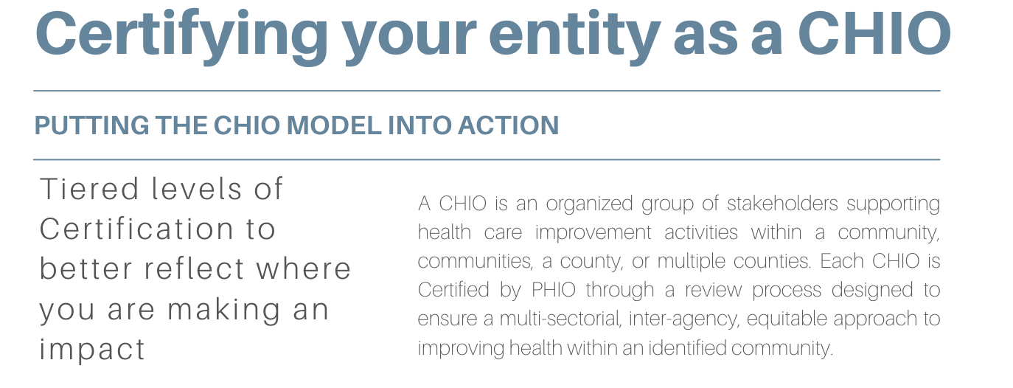
Levels of CHIO Certification
community Health Improvement Organizations
County Health Improvement Organization
County Health Improvement Organization Plus+
Notes:
Section Header Slide

Slide 18
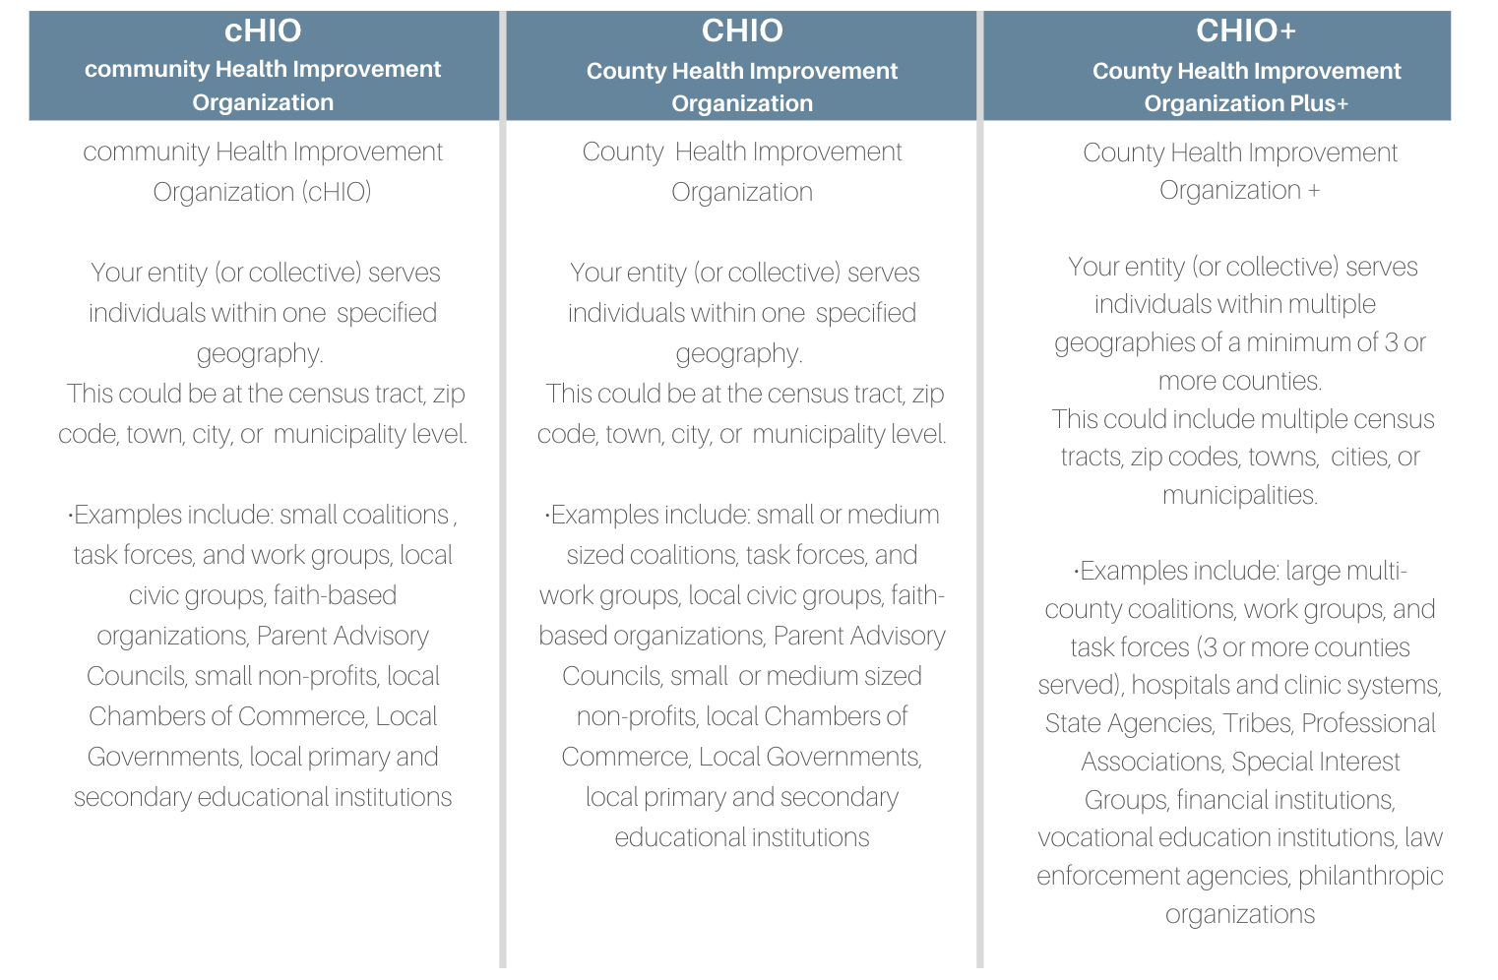
Levels of CHIO Certification
Notes:
Section Header Slide

Slide 19
Community Health Improvement Organization
community Health Improvement Organization (cHIO)
  Your entity (or collective) serves individuals within one specified geography.
  This could be at the census tract, zip code, town, city, or municipality level.
•Examples include: small coalitions , task forces, and work groups, local civic groups, faith-based organizations, Parent Advisory Councils, small non-profits, local Chambers of Commerce, Local Governments, local primary and secondary educational institutions
Notes:
One-section information slide

Slide 20
County Health Improvement Organization
County Health Improvement Organization
  Your entity (or collective) serves individuals within one specified geography.
  This could be at the census tract, zip code, town, city, or municipality level
•Examples include: small or medium sized coalitions, task forces, and work groups, local civic groups, faith-based organizations, Parent Advisory Councils, small or medium sized non-profits, local Chambers of Commerce, Local Governments, local primary and secondary educational institutions
Notes:
One-section information slide

Slide 21
County Health Improvement Organization Plus+
County Health Improvement Organization +
  Your entity (or collective) serves individuals within multiple geographies of a minimum of 3 or more counties.
  This could include multiple census tracts, zip codes, towns, cities, or municipalities.
•Examples include: large multi-county coalitions, work groups, and task forces (3 or more counties served), hospitals and clinic systems, State Agencies, Tribes, Professional Associations, Special Interest Groups, financial institutions, vocational education institutions, law enforcement agencies, philanthropic organizations
Notes:
One-section information slide

Slide 22
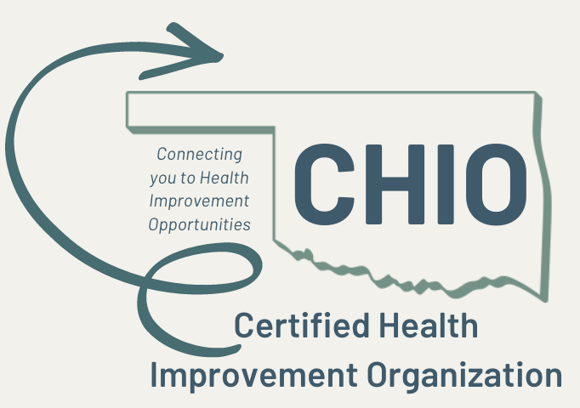
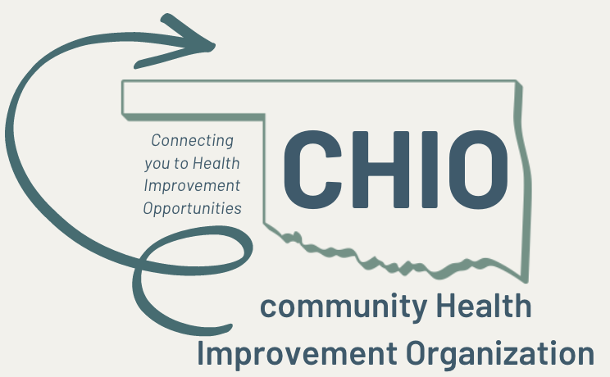
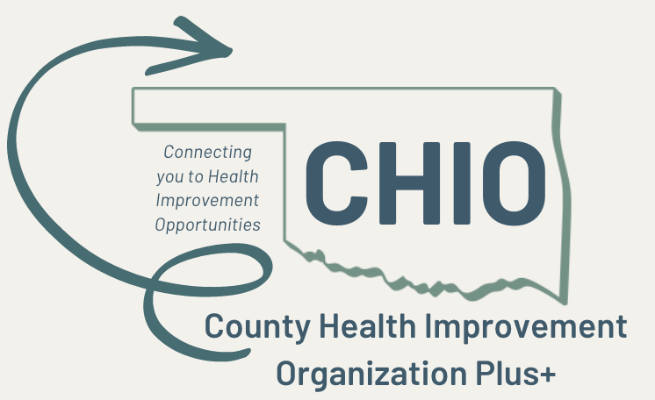
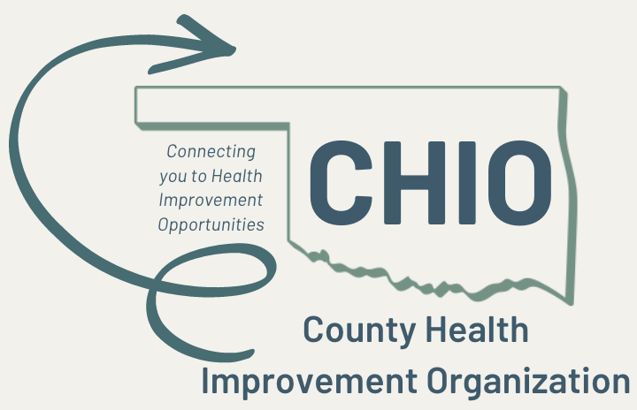
CHIO
Notes:
Agenda slide

Slide 23
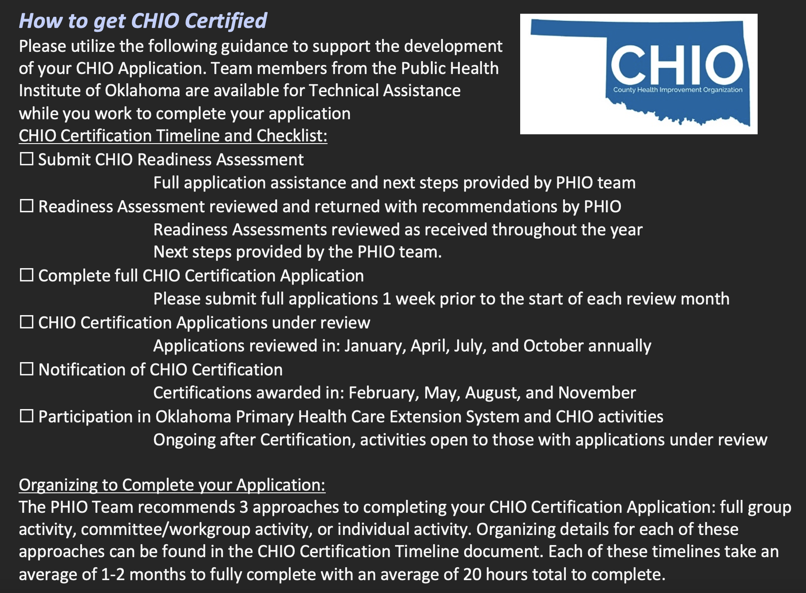
How to get your CHIO Certification
Notes:
One-section information slide

Slide 24
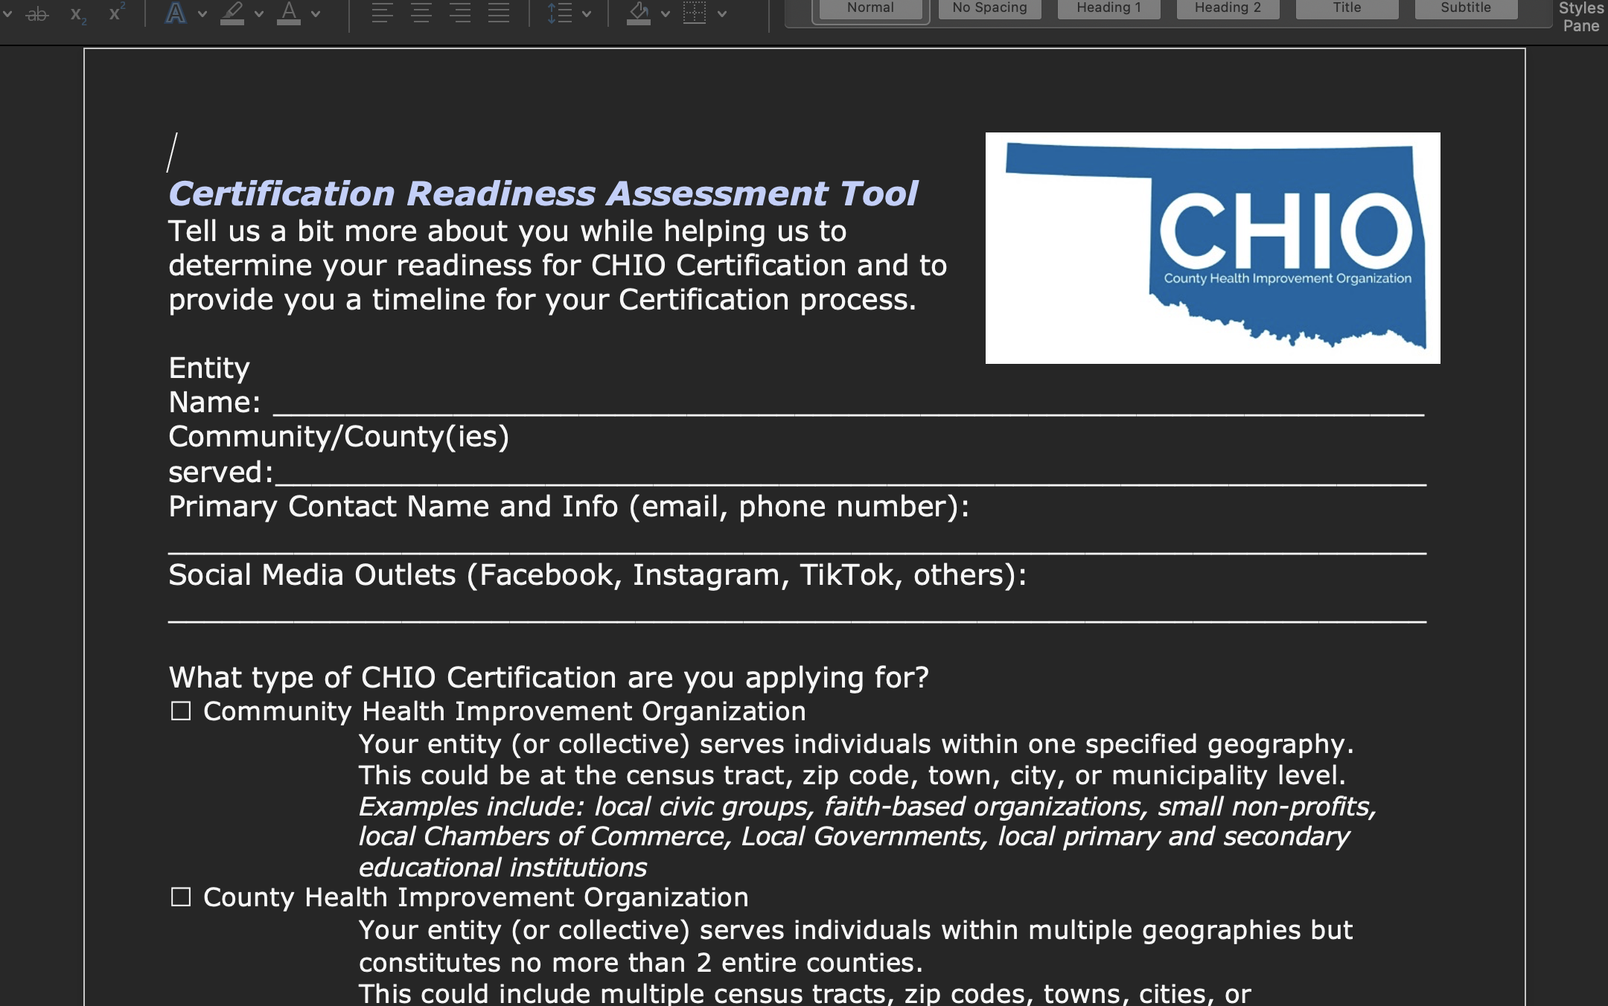
CHIO Readiness Assessment
Link to the Readiness Assessment
Notes:
One-section information slide

Slide 25
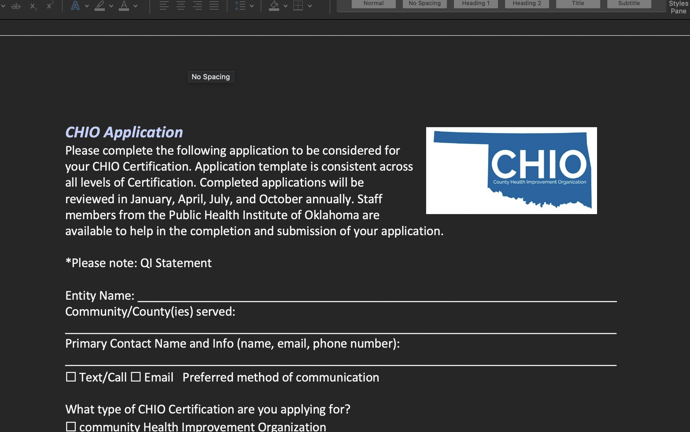
CHIO Application
Link to CHIO Application
Notes:
One-section information slide

Slide 26
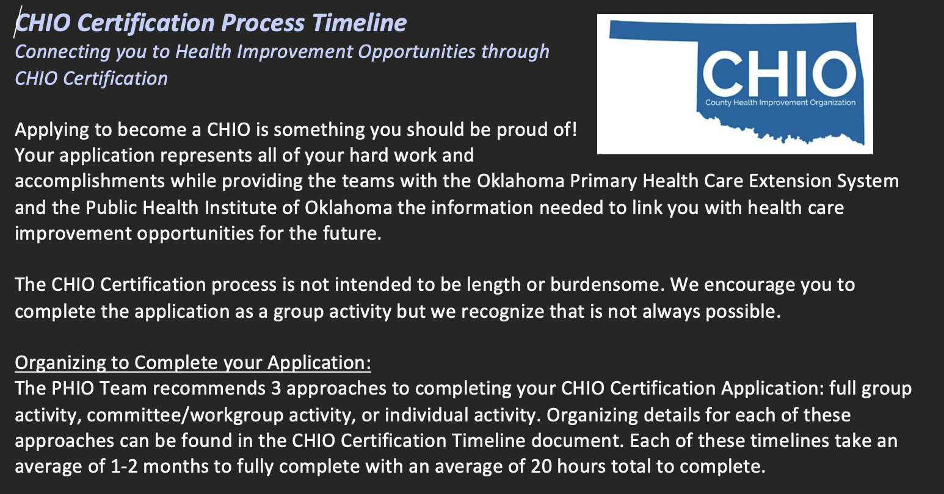
CHIO Certification Timeline
Notes:
Two-section information slide

Slide 27
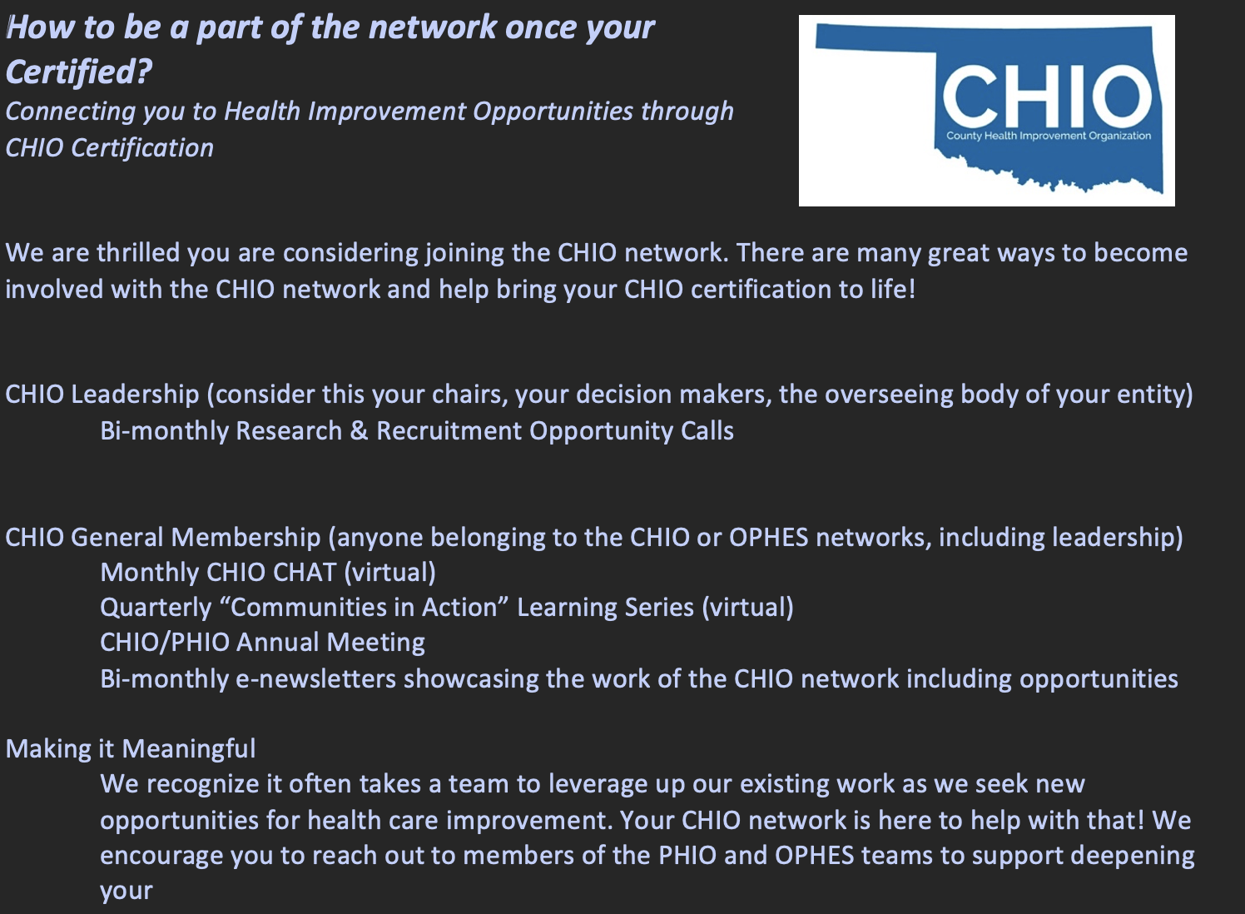
Making your CHIO Certification Meaningful
Notes:
Two-section information slide

Slide 28
Making your CHIO Certification work for you!
Examples from the field:
CATCH-UP 1.0
CATCH-UP 2.0
Handle with Care Oklahoma
Notes:
Agenda slide

Slide 29






CATCH-UP Oklahoma
Community-Engaged Approaches to Testing in Community Healthcare Settings and Community Based Organization for Underserved Populations in Oklahoma
PHIO Distributed of $888,000 in funds to communities
Incentivizing and supporting communities to support local COVID Relief Events

Slide 30
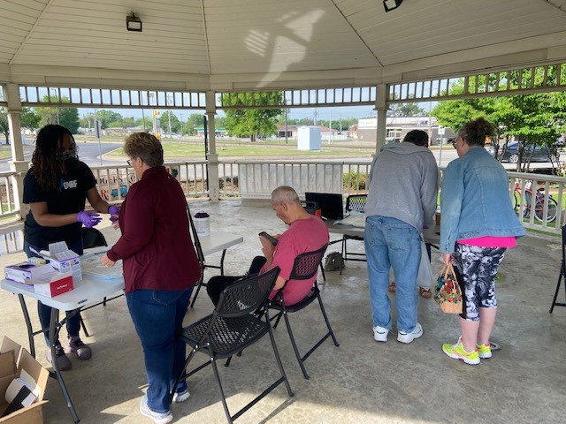
CATCH-UP Oklahoma 1.0
Community-Engaged Approaches to Testing in Community Healthcare Settings and Community Based Organization for Underserved Populations in Oklahoma
Video
Examples of Community Projects

Slide 31
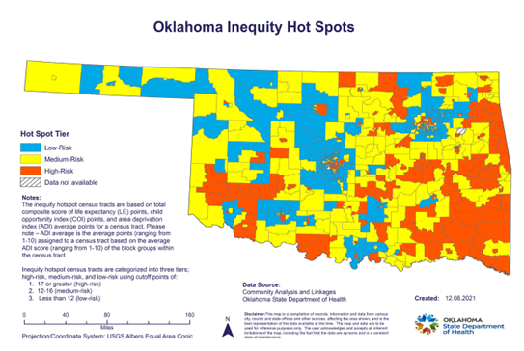
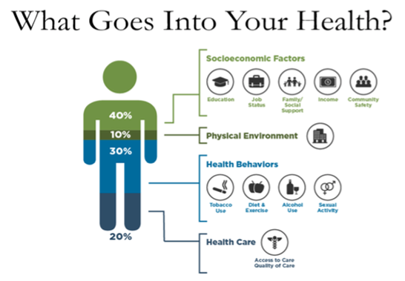
Why is this important?
Families across Oklahoma are experiencing disparities
Notes:
Adrienne
How does Oklahoma become a top ten state while addressing so many barriers?
Addressing social determinants of health is a unifying approach for interagency collaboration
SDOH can be addressed through targeted interventions, such as peer support groups, that incorporate Harvard’s straight-forward “Three Principles to Improve Outcomes for Children and Adults”:
1) Reduce sources of stress
2) Support responsive relationships
3) Strengthen core life skills

Slide 32
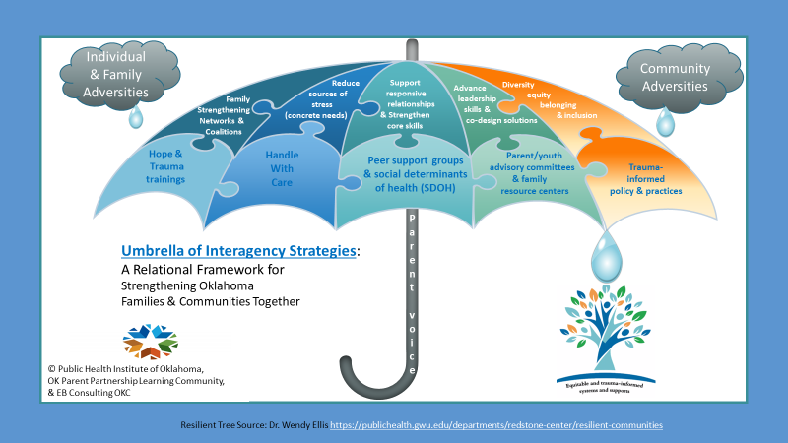
Notes:
Adrienne
Measuring Results & Interagency Logic Model: https://docs.google.com/document/d/1dcrR1dFKLnDjyDvDRf4upeqGKvjOXb4O/edit?usp=sharing&ouid=102895141314219214041&rtpof=true&sd=true
Interagency Trainings
https://docs.google.com/document/d/13Cf3EUH6OpUaIYUcexQ4HOVUJgxALN25/edit?rtpof=true

Slide 33
Putting the Model to Work
CATCH-UP Oklahoma 2.0
Expanding and focusing CATCH-UP Oklahoma efforts in the following areas:
-Panhandle: Texas, Cimarron, Beaver Counties
-Northwest: Grant, Garfield, Alfalfa Counties
-Southwest: Stephens, Jefferson, Oklahoma Counties
-Northeast: Cherokee, Rogers, Wagoner, Delaware Counties
-Southeast: Latimer, LeFlore Counties
Supporting assessments, evaluations, and readiness for:
-Community/County Health Improvement Organizations, Peer Support Groups, Handle with Care Oklahoma, Family/Community Advisory Councils, Family Resource/Community Resource/HOPE Centers, Self Healing Communities, Resource and Referral Platforms, Parent Partnership Learning Community, Oklahoma Turning Point Council, and many more!
-Staffed efforted thanks to support from the Oklahoma State Health Department
Notes:
Two-section information slide

Slide 34
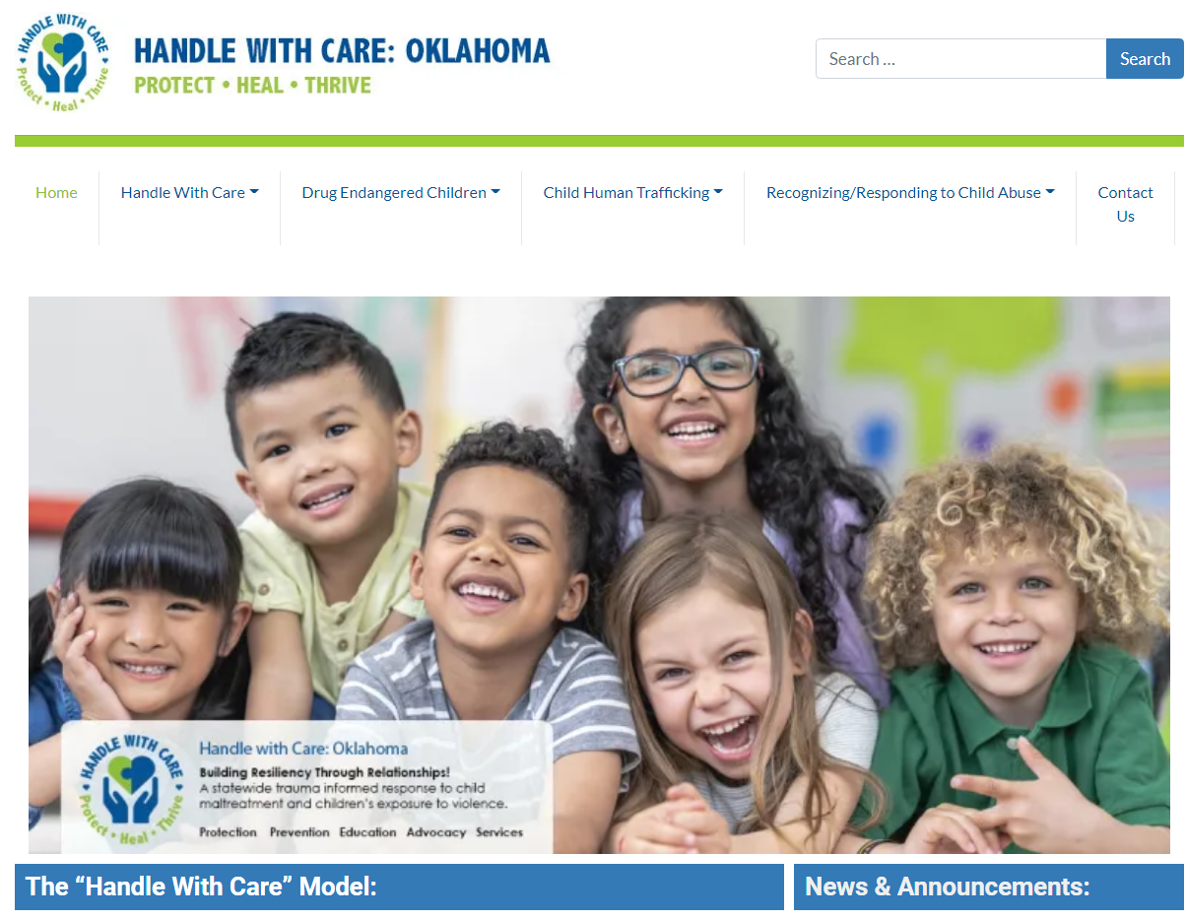


Statewide website: https://handlewithcareok.org/
Special thanks to PHIO and OTPC:
Notes:
With the support of the Public Health Institute of Oklahoma, an amazing neutral convener, we have established a statewide website and hold monthly community support calls to address barriers, celebrate milestones, and work with local communities to advance trauma-informed strategies across the state.

Slide 35




3 Simple Steps for Handle With Care
First Responder responds to a 911 call where a
school-age child/teen is a victim, witness, or bystander to a serious crime, traffic accident, arrest, or other.
First Responder makes a HWC notification via e-mail to school/child care agency: three words “Handle With Care” along with the name, age and school are included.
School district/daycare helps provide trauma-sensitive interventions, counseling and/or social services to student in crisis, the following school day, as needed.
Notes:
90% of children who have a Handle With Care notice can be supported with simple interventions, like snack/change of clothes/rest.

Slide 36

























Handle with Care
January 2022
Washington
Montana
Maine
North Dakota
Minnesota
Vermont
Oregon
New Hampshire
Idaho
South Dakota
Wisconsin
New
York
Massachusetts
Wyoming
Michigan
Rhode Island
Connecticut
Iowa
Pennsylvania
New Jersey
Nevada
Nebraska
Indiana
Ohio
DC
Delaware
Utah
Illinois
West
Virginia
Maryland
California
Colorado
Virginia
Kansas
Missouri
Kentucky
North
Carolina
Oklahoma
Tennessee
Arizona
New Mexico
Arkansas
South
Carolina
Alabama
Georgia
Mississippi
Interest
Development Phase
Active
Texas
Louisiana
Alaska
Florida
Hawaii
*Oklahoma is recognized as a top five state in the nation to have a statewide HWC initiative
Notes:
Oklahoma is one of the top five states in the nation to have a statewide initiative

Slide 37

Other exciting announcements!
Register Here.
Don’t forget!
Click here to access PHIOs Stakeholder Survey, we want to hear from you!
Notes:
Two-section information slide

Slide 38

Contact us!
Jill Hazeldine: jill@publichealthok.org
Laura Ross: laura@publichealthok.org
Adrienne Elder: Adrienne@publichealthok.org
Leigh Woody: leigh@publichealthok.org
Amber Costilla: amber@publichealthok.org
Dan Argo: dan@publichealthok.org
Kayla Matlock: kayla@publichealthok.org
Join us on Thursday, September 12, 2022 @2pm (CST) for the CATCH-UP Oklahoma 2.0 launch!
Register HERE.
Notes:
Two-section information slide

